Slide 1

kNK5u >smJ3i4 cspnDt5n5 XXb5 x7ml kNK5u >sJ3i4 cspn3i3j5
`rNs/c4vwA`t5
>m5y @)!#

Slide 2
kNK5u >smJ3i4 cspnDt5n5 XXb5 x7ml kNK5u >smJ3i4 cspn3i3j5 `rNs/c4vwA`t5
Wbc3m5 xuhi4 tt6vi4 xbJi4 sfkz XXb5 x7ml `rNs/c4vwA`t5
  1.) xgxZw5
  2.) `rNs/c4vwi3j5 grjxD`t5
  3.) cCns/4f5 WZhx3li ttC3=4n5
  4.) ~Nnsto3<h`t5 Gr4fgw8N3k5 g`Cz8q5g5H
WQxDtcMzJA5 ckwymizi4 XXb5; x7ml NlNwo3lQ5 x0p`Q8qAtq5 ]b4f m[Dw5.
Notes:
Read slide

Slide 3
kNK5u >smJ3i4 cspnDt5n5 XXb5
XXb5 xM4v3bsMs3ymJ5 `rNs/c3t5yA`t5
>smJ3i4 cspn3i3j5 vmQ/q5 kNK5u x7ml Z?m8gc4f8i WoE[=sJ5.
XXb5 Wbc4vwJ5 x[`CAb>m5 giscZ3i4 vmQlQ5
>smJ3i4 cspn3i3j5 yK9ostd/5 NlNw3bq5 >smJoEp3Jx5 x6ftQ9lQ5 NlNw/wiq5 >smJoEp3Jx5 x7ml x=5g3ymJi >smJoE>p5 tuqb xsM5yi3j5 x7ml cspn3i3j5 yK9ostd/q5 Wzhi x[Ag3ymiq8i kNK5.
Notes:
Article 5.2.37 of the NLCA states that “there is a need for an effective system of wildlife Management and to be effective, the system of management requires an efficient, coordinated research effort”.
In 1994 the Government of Canada provided the NWMB with $11 m in funds for the establishment of a Wildlife Research Fund (the Fund) which was intended to provide money for government departments to carry out wildlife research approved by the NWMB.
The Board established the Nunavut Wildlife Research Trust (NWRT), which was designated a Registered Charity in 1996.
The NWRT provides an annual allocation to address wildlife research priorities as identified by the NWMB through its identification of NWMB and Regional Wildlife Management and Research Priorities in the three regions of Nunavut.
Each year in December, the Trustees of the NWRT determine the amount of funding that will be available in each funding period based on the performance of the Trust. The NWMB responsibly manages the Trust to ensure that the funds continue to grow and are therefore available for wildlife research over the long-term.
Thanks to sound financial management, the fund’s current value is approximately $20 million, and has permitted the annual allocation of approximately $700,000 to $800,000 to researchers from the Department of Fisheries and Oceans, Canadian Wildlife Service (Environment Canada), Parks Canada, and the Government of Nunavut Department of Environment since its inception in 1994.

Slide 4
WZhx3li vmAysJ5
sfxgx6 Z?m8gc4f8i s}?~l8~i5 kNK5u Z?mq8i WoE[=sJ5 WA8N3g5 `rNs/c4vwAti4 XXbi4.
cspn3i6 vmQ/sQxo4 wlxi kNK5u Wdt]baym<J2 s}?~l8~i5 ciQ/q8i bEs5 Noq8i.
WZhxD`t5 XXbi4 gi/s?5g5 x6fbs9li cCns/4f5 sx/<j3g4f5 WZhxD5.
WZhx3li giyym[=sQxo4 >/8kxE !% x[`CAb>m5.
Notes:
The NWMB issues a call for proposals each year to government departments by October 1st
Only Federal or Nunavut territorial government departments are eligible for funding by the NWRT.
Research must be carried out within the Nunavut Settlement Area or adjacent marine areas
Applications to the NWRT are submitted via an internet-based electronic application system.
The application deadline is January 15 each year.

Slide 5
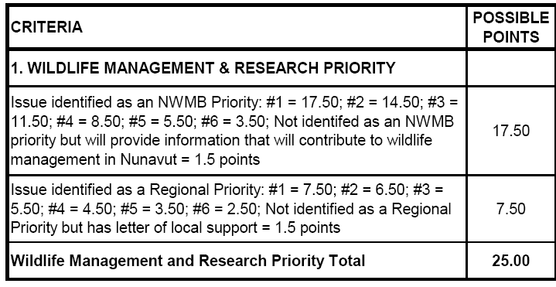
~Nnsto3hwis2 <xe5ymiz:
>smJoEp3Jx5 x7ml x=5g3ymJ5 yK9ostd/q5
XXbi4 ~Nnsto3hwi6 Wbc4vwJ6 d[?y8i3nu4 yK9ostd/i4 cspn3i3u4 bf8N3lQ5 >smJoEp3Jx5 yK9ostd/q5
Notes:
Research proposals that directly address the identified NWMB and regional wildlife management and research priorities receive higher scores.
NWMB priorities are based on roles and responsibilities of NWMB as set out in the s. 5.2.33 and 5.2.34 of the NLCA
Regional priorities identified through workshops held in conjunction with RWO AGMs every three years (next is Fall 2013)
List of current priorities sent out with call for applications each year.

Slide 6
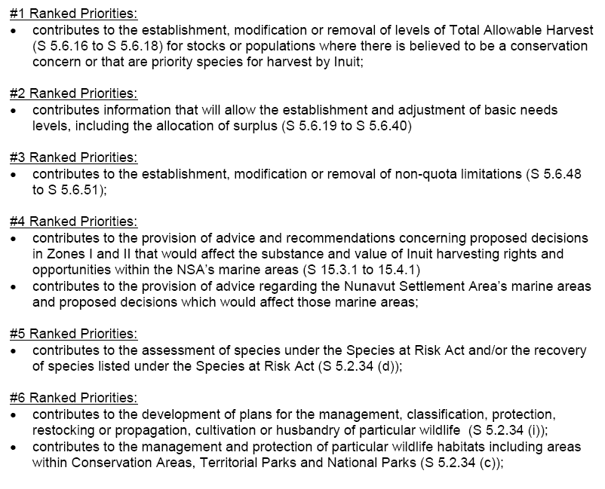
~Nnsto3hwis2 <xeh3ymiz: >smJoEp3Jx5 yK9ostd/q5
Notes:
Review the slide; note that regional priorities are numerous – indicate that hard copies are available if Board members wish to review them.

Slide 7
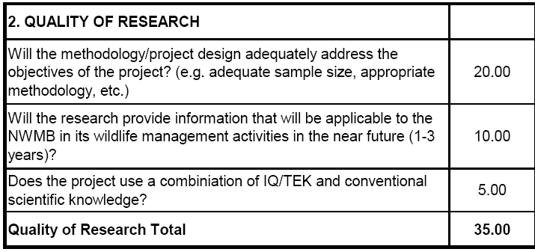
~Nnsto3hwis2 <xeh3ymiz:
Wsiz cspn3bs2
vmQ/5 gi/s?5g5 xu<hi3ni4 ~Nnsti4 cspn3i3u4 xgD8N3ix3gu4 >m8NDl4 x7ml wMc3lt4 wkw5 cspm/gcq84iFWsygc4f5 x?]bi4 cspm3i3u4.
Notes:
Important to include information related to all aspects of study design – not just field methods.
The NWMB encourages the use of available Inuit Qaujimajatuqangit in research

Slide 8
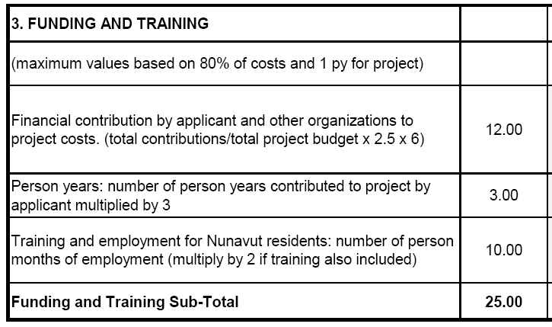
~Nnsto3hwis2 <xeh3ymiz:
`rNs/tA5 wvJD`t5
`rNs/tA5 wvJDtq5 WZhx3>g2 x7ml xyqb tusJ5 vtbs?2S5.
Notes:
Applicants receive up to 12 points based on the identification of financial contributions from other organizations
Confirmation of funding from these sources is therefore a standard condition on receiving the funding from the NWRT
For funding provided from within a department, an email from the Director of Research confirming the Department’s allocation of funds is sufficient
For external funding, we have the same expectations as other funding agencies – a copy of the funding notification letter
The NWRT will not fund budget items that do not directly support a proposed research project, such as equipment purchase, salaries, maintenance cost of equipment, administration fees and infrastructure costs.
There are also points awarded for time commitments by the applicant, and for training and employment opportunities for Nunavut residents.

Slide 9
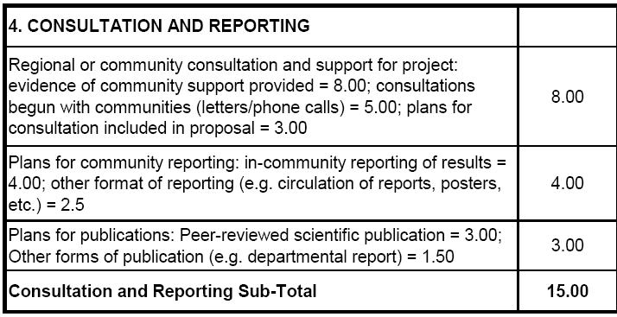
~Nnsto3hwis2 <xeh3ymiz: gn3=cChx3i6 x7ml si4>vos3i6
WZhx3g5 giyQx~o5 tt6vi4 wvJ3gDti4 kNo8i4 s}?~l8~i5 xM4vwlt4 x4hD3gt4 gn3=cCx3iExu4 g5yCstu8i.
Notes:
It is anticipated that most research will be done with the cooperation and active participation of local people.
Ideally proponents should obtain support from relevant HTOs, or from the RWOs if more than 5 communities are affected prior to applying for NWMB funds
Recognize that this isn’t always possible, but expect that at least minimum written contact has been made with all affected communities by the time of application.
To obtain full points for consultation, evidence of community support has to be provided with the application.
Obtaining these letters of support are a standard condition for all NWRT funding.
NWMB expects that departments will report the results of their work to local communities
Additional points are available if the applicant has plans in place to publish the results of the study

Slide 10
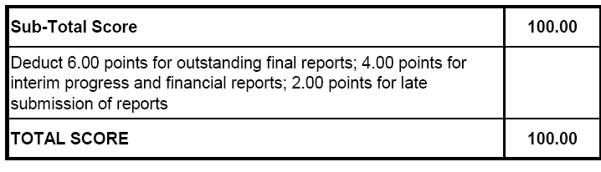
~Nnsto3hwis2 <xeh3ymiz: wM8zw/D`t5
~Nnsto3hwli <xe5ymJ6 wM8zwAbs?5g6 ~Nnsti4 giy7mw2Xb x7ml ra?3gt4 si4>vos3Xb.
Notes:
Failure to submit required reports, and submitting reports late has been an ongoing issue
Project leaders with late or outstanding reports are penalized for not adhering to the NWRT’s reporting requirements.
6 points for each outstanding final project report
4 points for each outstanding interim progress and financial report
2 points for each report submitted late
In some cases up to 20 points have been deducted as a result of outstanding reports
Deductions remain for outstanding reports until the NWMB receives them
Late submission deductions apply for one year

Slide 11
`rNs/c4vwA`t5 r9oq5 x7ml WcbsA8N3i6
g5yCs`t5 ~Nnst]bEx~o5 g<zis8q5g6 ^% vmQ/six3Xb >smJoEp3Jxk5.
vtm>p5 vmgw8NX8ix3g5 vtymJi4 d[?y8i3<Xi4 g5yCsti4 wmw2Xb xu<hi3nsq9lt4 !#%- c5ysiq8i4 xgw8Nw5 gi/si3u4.
grjx3t5yp >smJ3i4 xsM5yi3j5 n8qio4 xq8qi3u4 WZhxDti4 gi/s2Xb ~N7mZt4 NlNw/3ymiq5, ~N7mq2Xb `rNs/c4vwi3j5 xgxZ3k5 moZ5 s}?~l8~i5 wkwnlx3Xb
~Nnst]bq5, s}?~l8~i5 si4>vos3i3j5 WbcEx~o5 W/~E3bsm8q2Xb.
Notes:
Read 1 and 2
Re Points #1 and 2: If there is $600 k available to allocate to new projects in a given year, the proposals scoring at least 65% that can be brought to the Board cannot cumulatively request more than $810 k.
Hard to meet in the past couple of years because of a lack of detail, conflicting information in proposals as previously mentioned
Read 3

Slide 12
`rNs/c4vwA`t5 r9oq5 x7ml WcbsA8N3i6
g<zis8q5g6 %)- vt5gQ5 vmQ/s2
`rNs/3gDtq5 `rNs/c3tbsQx~o5 WZhx3gj5 s}?~l8~i5 xyq8i4 yM]bi4 W=5ni4.
vmQ/5 Wbc3g5 vt3hwi3u4 Wbc3gi4 ~Nnsti4
`rNs/c3tbsc5b0>/q5g5 w~M4 bm8N wMsQxc8q2X5 vmQ/j5 whmQ/sli Wbc9MEQxcExz W/~EChx3lQ5 >smJ34i xsM5yi3j5 x7ml cspn3i3j5 yK9ostd/5.
Notes:
Read 1 and 2

Slide 13
`rNs/c4vwA`t5 r9oq5 x7ml WcbsA8N3i6: x[`CAZn8k5 `rNs/c4vwA`t5
r9oc3g6 @%- sfx vt5gQ5 c5ysiq5 xgw8Nw5 `rNs/5.
vmQ/six3Xb, g5yCs`t5 ~N7mQx~o5 sf~kN6 tnm5 moZw5:
  cspn3i3j5 yK9ostd/6 + ^%-
  cspn3is2 Wsiz + &)-
  `rNs/c3tbsiz x7ml Wo7m5nwi6 + ^)-
  gn3=cChx3i6 x7ml si4>vos3i6 + &)-
Notes:
Funding for multi-year projects is limited to no more than 25% of the total amount available for funding
If there is $700 k available for allocation, $175 k is available for multiyear allocation
The first demand on this is for multi-year commitments from previous years (those in years 2 and 3 of their work)
All requests for multi-year funding must meet the following four criteria:
Research Priority (65% or 16.25 points / 25)
Research Quality (70% or 24.50 points / 30)
Funding and Training (60% or 15 points / 25)
Consultation and Reporting (70% or 10.50 points / 15)
Proposed multi-year projects will be considered for single year funding if the project does not meet the minimum requirements or if the maximum amount of funding for multi year projects has been met.
Projects receiving multi year finding will be reviewed on an annual basis and are contingent on interim project and interim financial reports

Slide 14
`rNs/c4vwA`t5 r9oq5 x7ml WcbsA8N3i6: yK3zA5 `rNs/c4vwA`t5
xu<hi3<X5 R!%,))) vmQ/j5.
r9oc3g5 !)- vt5gQ5 `rNs/c4vwA`t5 xgw8N5.
  >s5gCs`t5 yK3zA5 cspn3is2
  `rNs/c4vwAtk5:
  <xeh3lQ5 cspn3i3j5 vmAysJ5
  gn3=cChx3~i5 WZhx3li kN~o5 wvJDtq8i4
  whmQ/siq5 kN~o5 Wcbsiqb
  wMstbsiq5 wkw5 cspm/gcq5F Wsygc4f5 x?]bi4 cspm~i5
Notes:
Maximum $15,000 per project.
Limited to 10% of the total funding available.
Examples of what would qualify for preliminary study funding;
Development of research methods prior to undertaking a research project;
Consultations to obtain community support for a proposed study;
Consideration of opportunities for community involvement and participation in a research project; or
Consultation on how to include IQ/TEK in a research project.
A single project will only be eligible for preliminary study funding once
A project can’t receive preliminary and regular NWRT funding in the same year

Slide 15
gn3t5yA`t5 `rNs/c4vwi3j5 whmosDti4
g5yCs`t5 eu[D/s?5g5 vtmpk5 >m5yu vtm9lt4
w7u4f5 WZhx3g5 x7ml WoE[=zJ5 gn3tbs?8ix3g5 tt6vtA5 >smJoEp3Jx5
`rNs/4vwi3j5 whmosDtq8i4 etzi `w2Eo
w~l8Nt4 `rNs/c3tbsi3j5 mo4bsQx~o5 W/~E3bsQx~o5 tr8q8izi #) <Ji
>smJoEp3Jx5 <xe5hwA8N3g5 xy4v8iq8i4
`rNs/c3tbsi3j5 mo4bsQxo8i4 yK3zA5
`rNs/5 gi/siqb
Notes:
Proposals are reviewed by the Board during the March meeting, which is what we are here to do today.
Individual applicants and departments will be advised in writing of the NWMB’s funding decisions, including any conditions on funding, by mid-April
All funding conditions must be met by 30 June; there have been issues with this in the past, this year the deadline will be strictly enforced.
As per the NWRT policy, requests for extensions to meet funding conditions will be required on a case by case basis but must be made 2 weeks in advance of the June 30 deadline
Once all funding conditions have been met the NWMB will negotiate a Contribution Agreement with the associated government department by August 1st

Slide 16
kNK5u >smJ3i4 cspn3i3j5
`rNs/c4vwA`t5
cko>m6, x0pZMgw8Nz <xe5ymizb XXbw5
kNK5u >smJ3i4 cspn3i3j5 `rNs/c4vwA`t5 G`rNs/c4vwA`t5H xM4vMs3ym/q5 >smJoEp3Jx5
`rNs/c3t5gQ5 kNo8i4 g8z=o8i4 xsM5y~i5 x7ml cspn3i3j5 vmQ/5 kN5u, Wlx3gu4, vmQ/q5 mfx xaNh4`t5 x7ml urQx3ix3`t5 tuqb.
vmQ/~o5 W0JbsJi4 kNo8k5 wh>mlAti4.
Notes:
Very similar structure to NWRT
Nunavut Wildlife Studies Fund (NWSF) was created by the NWMB to fund community-based management and research projects in Nunavut, in particular projects led by Hunters and Trappers Organizations. Other community-based organizations and individual beneficiaries are also able to apply.
The NWMB Studies Fund is intended to address wildlife management issues of local concern, and is available only to Nunavut community-based researchers.
The NWSF provides an annual allocation of funds from it’s annual operating budget to encourage Inuit and community-based organizations to undertake and lead research projects that address community needs and concerns related to the management of wildlife in Nunavut.

Slide 17
kNK5u >smJ3i4 cspn3i3j5
`rNs/c4vwA`t5
Wbc8q5g6 x[`CAZn8k5 `rNs/c4vwAti4
xu<hi3<X5 xgw8Nw5 R#),))) vmQ/j5
xu<hi3<X5 yK3zA5 `rNs/c4vwA`t5 R&,%)).
w6vNw/3`t5 WoEctcD8N3g5 WZhxDmJi4
<xeh3lQ5 vmAyEAm/q5 cspn3i3u4, s}?~l8~i5 sc3=cD8N3g5 WZhx3gi4 W[=QZhx3lQ5 gnC5nv8i3i4 eu[DoDt4.
Notes:
There is no option for multi-year funding
Maximum amount is $30 k regular funding and $7,500 preliminary study funding
Similar application process, but:
Policy allows NWMB staff to work with potential applicants on developing appropriate methodology and projects budgets
For many applicants, it’s their first time conducting research of filling out a funding application

Slide 18
kNK5u >smJ3i4 cspn3i3j5
`rNs/c4vwA`t5
Z?m8f5 kNK5u cspn3tq5 wvJD8N3g5 xaNh4goEpi4 WZhx3t9lQ5 x7ml cspn3t9lQ5, ryxi xaNh4goE>p5 tAux3g5 w2WQ/c3i3u4 w~l8Nq8i4 tt6vi4 sKz >smJoEp3Jxk5 x7ml giyQxc3i3u4 w~l8Nq8i4 WbcExo8i4 tt6vi4.
Notes:
Read slide
Project lead must be HTO or other community organization
Same reporting requirements as with NWRT, and must be prepared and submitted by the project lead

Slide 19
~Nnsto3hwis2 <xeh3ymiz
~Nnsto3hwis2 <xeh3ymiz x0pZMz sfx XXb5 ryxi >m8NDl4 xy0pD`t5 xgxZ3k5 xM4vwJ5 WsyEZhx3bzi `rNs/c4vwA`t5 g`C3gQ5 kNo8i4 g8z=~o5 tusJ5:
  `rNs/tA5 wvJDtq5
  gn3=cChx3i6 x7ml si4>vos3i6
  X3NA`t5 sco>mZ3~k3bsZ/3iq8k5
  vmQ/5 ~Nnst]bEx~o5 %)- gi/six3Xb vtmpk5 vmQ/si3u4
Notes:
Priorities and Quality of Research the same as NWRT.
Financial contribution differences: Where the financial contribution is calculated in NWRT for a maximum value of 12 points, a similar calculation is used in NWSF, but only for a maximum of 6 points. The remaining 6 points are given based on a general evaluation of the components of the budget; therefore, less weight is given to the actual percentage of funds that have been committed by other parties.
Consultation and Reporting differences: less of a focus on providing evidence of community support, more focus on simply meeting face-to-face with other community organizations and/or the public and; publication criteria are less dependent on peer-review, are aligned with reporting to government departments, schools and community organizations.
Plans for publication differences: Rather than aim for peer reviewed scientific publications, the focus of this section is on encouraging applicants to share the results of their work with government departments and other wildlife management agencies. Points are also awarded to those who plan to share their results with other members of the community, including through public meetings and presentation to school groups for example.

Slide 20
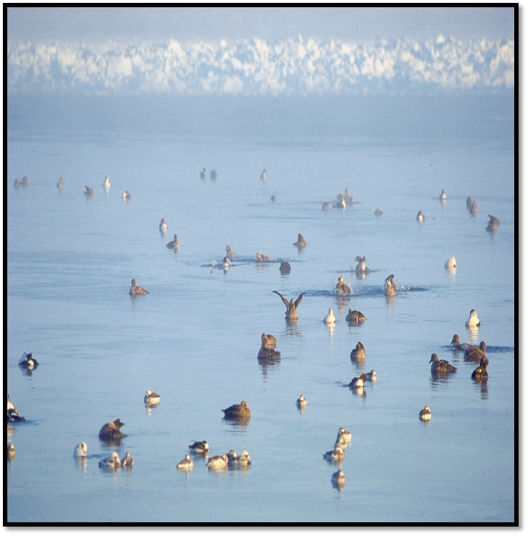
xW6f`t5 F scsy5n5V
mlxE, @))(. si4>vq5 >smJoEp3Jxk5. m2W3gZ5 !%_!^.
Notes:
Have a couple of hard copies of:
With NWMB and regional priorities
The NWRT Funding Guide
The NWSF Funding Guide
An overview of the online application system
Outstanding funding conditions and reporting requirements for 2013-2014
Have a stick here with these documents as well

