Slide 1

Nunavut Wildlife
Research Trust and Studies Fund
March 2013

Slide 2
Nunavut Wildlife Research Trust &
Nunavut Wildlife Studies Fund
There are a number of documents that relate to the NWRT and NWSF:
  1.) Policies
  2.) Funding Guides
  3.) Online application forms
  4.) Score sheets (not public documents)
We will start with an overview of the NWRT; then identify the differences between the two.
Notes:
Read slide

Slide 3
Nunavut Wildlife Research Trust
The NWRT was created to fund wildlife research conducted by territorial and federal government departments.
The NWRT provides an annual allocation to address wildlife research priorities as identified by NWBM through its identification of NWMB and Regional Wildlife Organization Management and Research Priorities in the three regions of Nunavut.
Notes:
Article 5.2.37 of the NLCA states that “there is a need for an effective system of wildlife Management and to be effective, the system of management requires an efficient, coordinated research effort”.
In 1994 the Government of Canada provided the NWMB with $11 m in funds for the establishment of a Wildlife Research Fund (the Fund) which was intended to provide money for government departments to carry out wildlife research approved by the NWMB.
The Board established the Nunavut Wildlife Research Trust (NWRT), which was designated a Registered Charity in 1996.
The NWRT provides an annual allocation to address wildlife research priorities as identified by the NWMB through its identification of NWMB and Regional Wildlife Management and Research Priorities in the three regions of Nunavut.
Each year in December, the Trustees of the NWRT determine the amount of funding that will be available in each funding period based on the performance of the Trust. The NWMB responsibly manages the Trust to ensure that the funds continue to grow and are therefore available for wildlife research over the long-term.
Thanks to sound financial management, the fund’s current value is approximately $20 million, and has permitted the annual allocation of approximately $700,000 to $800,000 to researchers from the Department of Fisheries and Oceans, Canadian Wildlife Service (Environment Canada), Parks Canada, and the Government of Nunavut Department of Environment since its inception in 1994.

Slide 4
Application Process
Only Federal or Nunavut territorial government departments are eligible for funding by the NWRT.
Research must be carried out within the Nunavut Settlement Area or adjacent marine areas
Applications to the NWRT are submitted via an internet-based electronic application system.
Application deadline January 15 each year.
Notes:
The NWMB issues a call for proposals each year to government departments by October 1st
Only Federal or Nunavut territorial government departments are eligible for funding by the NWRT.
Research must be carried out within the Nunavut Settlement Area or adjacent marine areas
Applications to the NWRT are submitted via an internet-based electronic application system.
The application deadline is January 15 each year.

Slide 5
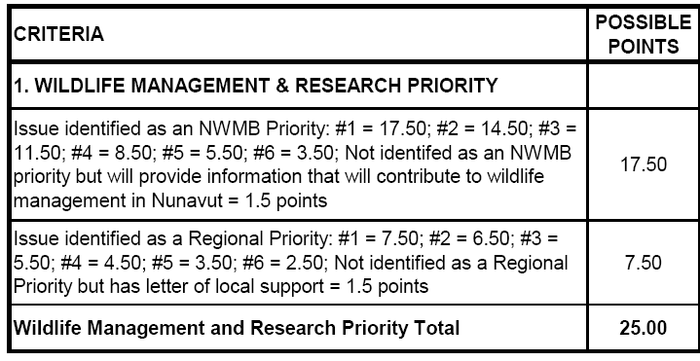
Scoring Structure:
NWMB and Regional Priorities
NWRT scoring gives higher priority to research focused on NWMB priorities.
Notes:
Research proposals that directly address the identified NWMB and regional wildlife management and research priorities receive higher scores.
NWMB priorities are based on roles and responsibilities of NWMB as set out in the s. 5.2.33 and 5.2.34 of the NLCA
Regional priorities identified through workshops held in conjunction with RWO AGMs every three years (next is Fall 2013)
List of current priorities sent out with call for applications each year.

Slide 6
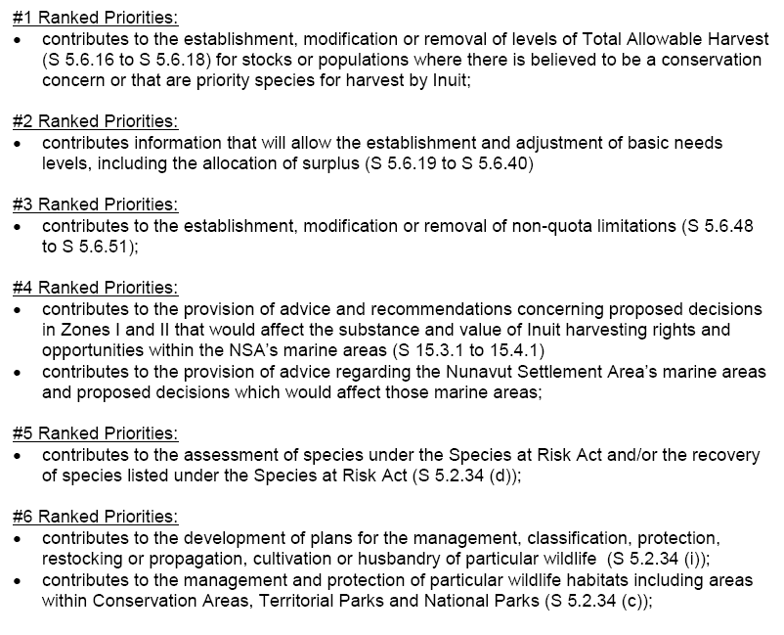
Scoring Structure: NWMB Priorities
Notes:
Review the slide; note that regional priorities are numerous – indicate that hard copies are available if Board members wish to review them.

Slide 7
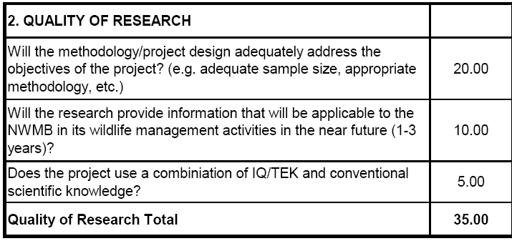
Scoring Structure:
Quality of Research
Projects are awarded more points for research that will be applicable in the near future and that includes IQ/TEK.
Notes:
Important to include information related to all aspects of study design – not just field methods.
The NWMB encourages the use of available Inuit Qaujimajatuqangit in research

Slide 8
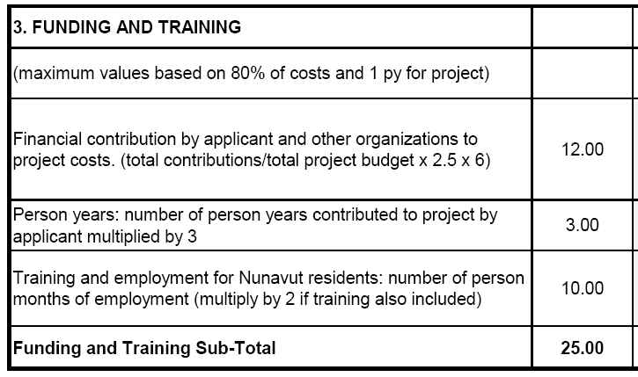
Scoring Structure:
Financial Contributions
Financial contributions by the applicant and other organizations are combined.
Notes:
Applicants receive up to 12 points based on the identification of financial contributions from other organizations
Confirmation of funding from these sources is therefore a standard condition on receiving the funding from the NWRT
For funding provided from within a department, an email from the Director of Research confirming the Department’s allocation of funds is sufficient
For external funding, we have the same expectations as other funding agencies – a copy of the funding notification letter
The NWRT will not fund budget items that do not directly support a proposed research project, such as equipment purchase, salaries, maintenance cost of equipment, administration fees and infrastructure costs.
There are also points awarded for time commitments by the applicant, and for training and employment opportunities for Nunavut residents.

Slide 9
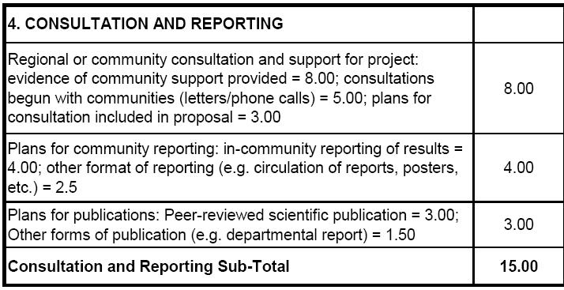
Scoring Structure:
Consultation and Reporting
Applicants are required to provide a letter of support from communities or demonstrate conscientious consultation in their proposals.
Notes:
It is anticipated that most research will be done with the cooperation and active participation of local people.
Ideally proponents should obtain support from relevant HTOs, or from the RWOs if more than 5 communities are affected prior to applying for NWMB funds
Recognize that this isn’t always possible, but expect that at least minimum written contact has been made with all affected communities by the time of application.
To obtain full points for consultation, evidence of community support has to be provided with the application.
Obtaining these letters of support are a standard condition for all NWRT funding.
NWMB expects that departments will report the results of their work to local communities
Additional points are available if the applicant has plans in place to publish the results of the study

Slide 10
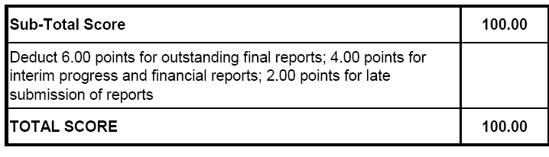
Scoring Structure:
Deductions
The scoring system deducts points for outstanding and late reporting.
Notes:
Failure to submit required reports, and submitting reports late has been an ongoing issue
Project leaders with late or outstanding reports are penalized for not adhering to the NWRT’s reporting requirements.
6 points for each outstanding final project report
4 points for each outstanding interim progress and financial report
2 points for each report submitted late
In some cases up to 20 points have been deducted as a result of outstanding reports
Deductions remain for outstanding reports until the NWMB receives them
Late submission deductions apply for one year

Slide 11
Funding Limitations & Eligibility
Proposals must score a minimum of 65 points to be considered by the NWMB.
The Board will only consider a package of the top ranked proposals making up not more than 135% of the amount available to allocate.
The Director of Wildlife Management has the authority to reject applications that are not submitted in adequate detail, do not meet the funding guide criteria or minimum score, or where reporting requirements have not been met.
Notes:
Read 1 and 2
Re Points #1 and 2: If there is $600 k available to allocate to new projects in a given year, the proposals scoring at least 65% that can be brought to the Board cannot cumulatively request more than $810 k.
Hard to meet in the past couple of years because of a lack of detail, conflicting information in proposals as previously mentioned
Read 3

Slide 12
Funding Limitations & Eligibility
At least 50% of the total project budget must be funded by the applicant or other external sources.
Projects that involve the compilation of existing data will not be funded unless this is an integral part of a project which is judged to be necessary in meeting wildlife management and research priorities.
Notes:
Read 1 and 2

Slide 13
Funding Limitations & Eligibility:
Multi-year Funding
Limited to 25% of the total amount available for funding.
To be considered, proposals must meet the following four criteria:
  Research Priority = 65%
  Research Quality = 70%
  Funding and Training = 60%
  Consultation and Reporting = 70%
Notes:
Funding for multi-year projects is limited to no more than 25% of the total amount available for funding
If there is $700 k available for allocation, $175 k is available for multiyear allocation
The first demand on this is for multi-year commitments from previous years (those in years 2 and 3 of their work)
All requests for multi-year funding must meet the following four criteria:
Research Priority (65% or 16.25 points / 25)
Research Quality (70% or 24.50 points / 30)
Funding and Training (60% or 15 points / 25)
Consultation and Reporting (70% or 10.50 points / 15)
Proposed multi-year projects will be considered for single year funding if the project does not meet the minimum requirements or if the maximum amount of funding for multi year projects has been met.
Projects receiving multi year finding will be reviewed on an annual basis and are contingent on interim project and interim financial reports

Slide 14
Funding Limitations & Eligibility:
Preliminary Funding
Maximum $15,000 per project.
Limited to 10% of the total funding available.
  Examples of preliminary study funding:
  Development of research methods
  Consultations to obtain community support
  Consideration of community participation
  Inclusion of IQ/TEK
Notes:
Maximum $15,000 per project.
Limited to 10% of the total funding available.
Examples of what would qualify for preliminary study funding;
Development of research methods prior to undertaking a research project;
Consultations to obtain community support for a proposed study;
Consideration of opportunities for community involvement and participation in a research project; or
Consultation on how to include IQ/TEK in a research project.
A single project will only be eligible for preliminary study funding once
A project can’t receive preliminary and regular NWRT funding in the same year

Slide 15
Notification of Funding Decisions
Proposals are reviewed by the Board during the March meeting
Individual applicants and departments will be advised in writing of the NWMB’s funding decisions by mid-April
All funding conditions must be met by 30 June
The NWMB may establish additional funding conditions prior to funding being issued
Notes:
Proposals are reviewed by the Board during the March meeting, which is what we are here to do today.
Individual applicants and departments will be advised in writing of the NWMB’s funding decisions, including any conditions on funding, by mid-April
All funding conditions must be met by 30 June; there have been issues with this in the past, this year the deadline will be strictly enforced.
As per the NWRT policy, requests for extensions to meet funding conditions will be required on a case by case basis but must be made 2 weeks in advance of the June 30 deadline
Once all funding conditions have been met the NWMB will negotiate a Contribution Agreement with the associated government department by August 1st

Slide 16
Nunavut Wildlife Studies Fund
Overall, very similar structure to NWRT
The Nunavut Wildlife Studies Fund (NWSF) was created by the NWMB to fund community-based management and research projects in Nunavut, in particular, projects led by Hunters and Trappers Organizations.
Addresses issues of local concern.
Notes:
Very similar structure to NWRT
Nunavut Wildlife Studies Fund (NWSF) was created by the NWMB to fund community-based management and research projects in Nunavut, in particular projects led by Hunters and Trappers Organizations. Other community-based organizations and individual beneficiaries are also able to apply.
The NWMB Studies Fund is intended to address wildlife management issues of local concern, and is available only to Nunavut community-based researchers.
The NWSF provides an annual allocation of funds from it’s annual operating budget to encourage Inuit and community-based organizations to undertake and lead research projects that address community needs and concerns related to the management of wildlife in Nunavut.

Slide 17
Nunavut Wildlife Studies Fund
There is no option for multi-year funding
Maximum amount available is $30,000 per project
Maximum preliminary funding is $7,500.
Staff can work with potential applicants to develop an approach to their research, or may contact applicants to obtain more information during evaluation.
Notes:
There is no option for multi-year funding
Maximum amount is $30 k regular funding and $7,500 preliminary study funding
Similar application process, but:
Policy allows NWMB staff to work with potential applicants on developing appropriate methodology and projects budgets
For many applicants, it’s their first time conducting research of filling out a funding application

Slide 18
Nunavut Wildlife Studies Fund
Government of Nunavut researchers can support the HTOs with applications and research, however the HTO maintains responsibility for all correspondence with the NWMB and submission of all required documents.
Notes:
Read slide
Project lead must be HTO or other community organization
Same reporting requirements as with NWRT, and must be prepared and submitted by the project lead

Slide 19
Scoring Structure
Scoring Structure similar to NWRT but recent changes to the policy reflect the intention of the NWSF to target community-based organizations:
  Financial Contributions
  Consultation and Reporting
  Plans for publication
  Projects must score 50% to be brought to the Board for consideration
Notes:
Priorities and Quality of Research the same as NWRT.
Financial contribution differences: Where the financial contribution is calculated in NWRT for a maximum value of 12 points, a similar calculation is used in NWSF, but only for a maximum of 6 points. The remaining 6 points are given based on a general evaluation of the components of the budget; therefore, less weight is given to the actual percentage of funds that have been committed by other parties.
Consultation and Reporting differences: less of a focus on providing evidence of community support, more focus on simply meeting face-to-face with other community organizations and/or the public and; publication criteria are less dependent on peer-review, are aligned with reporting to government departments, schools and community organizations.
Plans for publication differences: Rather than aim for peer reviewed scientific publications, the focus of this section is on encouraging applicants to share the results of their work with government departments and other wildlife management agencies. Points are also awarded to those who plan to share their results with other members of the community, including through public meetings and presentation to school groups for example.

Slide 20
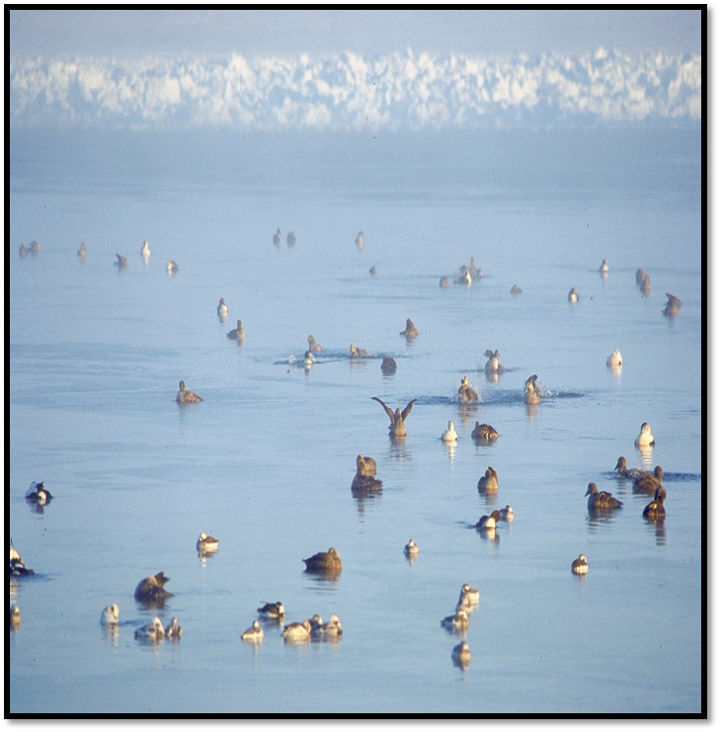
Questions / Comments ?
Mallory, M. 2009. Presentation to NWMB. pp. 15-16.
Notes:
Have a couple of hard copies of:
With NWMB and regional priorities
The NWRT Funding Guide
The NWSF Funding Guide
An overview of the online application system
Outstanding funding conditions and reporting requirements for 2013-2014
Have a stick here with these documents as well

