Slide 1
Pitquyautjutit Nunavut Uumayulirinikkut Munarinikkut Katimayiit (NWBM)
Qingaup tuktuit
Recommendations to the NWBM
Bathurst Caribou
Nunavut Kavamat/Government of Nunavut
Avatiliqiyikkut Havakvia/Department of Environment
June, 2016

Slide 2
Nunavut Kavamatkunni Avatiliqiyikkut Havakviat havagutaa
Government of Nunavut, DOE mandate
Avatiliqiyikkut Havakviani Uumayulirinikkut havakviat maligakkut havagutiqaqtut munarinikkut nunani uumayunik Nunavunmi, ilauyullu aularaanginnaqtunik munarinirnik atauttikkut-aulapkaitjutainni Nunavumi uumayuni pitquyauhimayumi ataani Nunavunmi Nunatarnikkut Angirutimi (NLCA).
Atauhiuyuqlu pilluarumayainni turaanganirniani Havakviup pinikkut ihuaqtumik pitjutikhanik uumayuni munaritjutainni atuqpaktut tamarnik qauyiharutinik–naunaqtunik uumingalu Inuit Qaujimajatuqanginnik (IQ).
Havakniarhimayait
Havakniarhimayait Uumayulirinikkut Munarinikkut havakviat hapkuat:
Tuniluni uplumiutanik ilitturipkaitjutinik taapkunannga naliinni pivigiyauyunin;
Piliurluni uumayulirinikkut munarinikkut hivunikhanik munariniqatigiiqaqtuni paannariyainni hapummiyaami uumayunik amigainniinnik;
Tuniluni ikayurutinik aturutikhaniklu munariniqatigiiqaqtuni paannanun anguniaqtununlu; imaalu,
Pipkailuni maligakkut maligaghakkullu maliktauyut taapkunuuna iliharnikkut maliktipkainikkullu.
The DOE Wildlife Management division has a legislated mandate for the management of terrestrial wildlife species in Nunavut, including on-going responsibility for the co-management of Nunavut wildlife as obligated under the NLCA.
One of the primary goals of the Division is to achieve a balanced approach to wildlife management that uses both science and Inuit Qaujimajatuqangit (IQ).
Objectives
The objectives of the Wildlife Management division are to:
Provide up-to-date information from various sources;
Develop wildlife management plans with co-management partners in order to protect wildlife populations;
Provide support and resources to co-management partners and harvesters;
and,
Ensure legislative and regulatory compliance through education and enforcement.
Notes:
Bullet point:
1) including in-house scientific research and Inuit Qaujimajatuqangit, to co-management partners in order to make responsible wildlife management and land use recommendations;

Slide 3
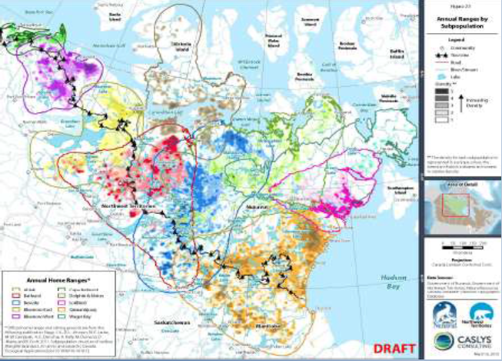
Munarinikkut Tuktunik – Humiinniit
Monitoring Caribou –Distribution
Nunami humiinniit nunami ukiiviit tuktuit. Ilangit nayugait tikitpaktut Yukon-mun, Alberta-mun, Saskatchewan-mun Manitoba-munlu .
Geographical distribution of barren-ground and tundra wintering caribou herd. Portions of ranges extend into Yukon Territory, Alberta, Saskatchewan and Manitoba .

Slide 4
Munarinikkut – Qingaup tuktuit
Monitoring –Bathurst Caribou
Talvannga 2006-min 2009-mun tuktuit ikikliyuummiqtut 32,000-nik tuktuqalirhutik. 2012-mi, imaakiak amigaitilaanguyuq 35,000-nik tuktunik ihumagiyaupluni tuktuit aulahimmaaqtut talvannga 2009-min 2012-mun.
From 2006 to 2009 the herd declined to about 32,000 caribou. In 2012, the herd was estimated at 35,000 caribou suggesting the herd had been relatively stable from 2009 to 2012.

Slide 5
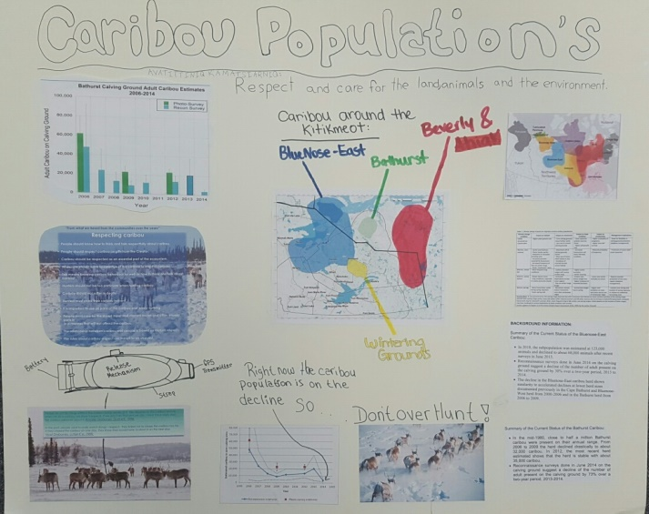
Miitiqtipkaitjutit
Consultations
Tatqiqhiutikkut/Ukiuq tamaat Tunnganiqarnikkut:
Unniutitjut qauyiharnirmi Anguhiqiyitkunnun (HTOs) ukunungalu Kitikmeot Avikturhimaningani Uumayulirinikkut Katimayiinnun (KRWB)
Unniutitjut inungnun
Monthly/Annual Basis:
Report on the survey results to the HTOs and KRWB
Report to the public

Slide 6
Miitiqtipkaitjutit
Consultations
Miitirniit:
Aularaanginnaqtut Munarinikkut hivunikhanik miitirniit
Aularaanginnaqtut Inungnun miitiqaqtiigiikniit
Katimaniit uvani Ualliani Kitikmeot tuktuit qanurinningani, imaa 2007-mi katimanirmi Kugluktukmi
Meetings:
Ongoing Management plan meetings
Ongoing Public consultations
Workshops on West Kitikmeot caribou status, such as the 2007 workshop in Kugluktuk

Slide 7
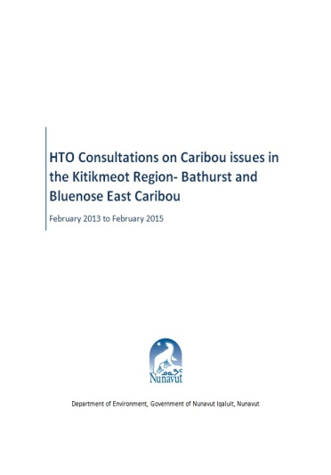
2014-2015 Consultations
  September 9, 2014 - Kugluktuk HTO katimayiit miitirniq
  September 22, 2014 – Kugluktumiunun ilitturipkainiq miitiqatigiiknirlu
  October 1, 2014 – Umingmaktuuq Qingauklu HTO miitirniit
  October 9-10, 2014 – NWT Naunavyaktuni Miitirniq 1, GN-kut NTI-kullu ilauyut
  October 15-18, 2014 - KWRB miitiryuarniq
  October 22-23, 2014 – NWT Miitirniq 2, GN-kut ilauyut
  October 31, 2014 - Kugluktuk HTO katimayiit miitiqtut.
  January 30, 2015 – Qingauk Umingmaqtuuqlu (Tamatqiqhimayut Pitquyauhimayut Anguniaqtauyukhat (TAH))
  February 11, 2015 – Kugluktuk HTO (TAH)
  September 9, 2014 - Kugluktuk HTO board meeting
  September 22, 2014 - Kugluktuk community information and consultations
  October 1, 2014 - Bay Chimo and Bathurst HTO meeting
  October 9-10, 2014 – NWT Technical Meeting 1, GN and NTI participation
  October 15-18, 2014 - KWRB AGM meeting
  October 22-23, 2014 – NWT Technical Meeting 2, GN participation
  October 31, 2014 - Kugluktuk HTO board meeting.
  January 30, 2015 – Bathurst and Bay Chimo (TAH)
  February 11, 2015 – Kugluktuk HTO (TAH)

Slide 8
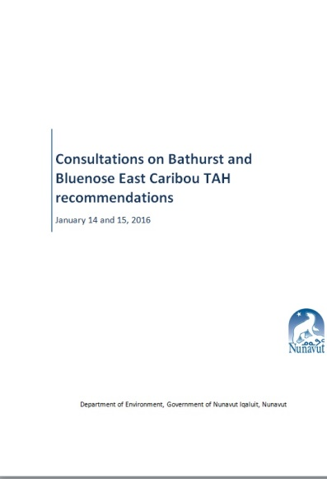
Tuktuni Anguniaqtauyukhani Miitiqtipkaitjutit 2016
Caribou Harvest Consultation 2016
January 2016-mi
Miitiqaqtigivaktait hulaqutihimayut Anguhiqiyitkut (HTOs) Kitikmeot Avikturhimaningani Uumayulirinikkut Katimayiinnunlu (KRWB), ukunani aallanguqtirhimayuni nutaani Tamatqiqhimayut Pitquyauhimayut Anguniaqtauyukhat (TAH) pitquyauhimayuni (Ikaluktuuttiaq).
    March 2016-mi, GN DOE tuniyuq tukhiqtauhimayunik pitquitjutimik Tamatqiqhimayut Pitquyauhimayut Anguniaqtauyukhat (TAH) imaatut 30 anguhallunik tuktunik uvani Qingaup tuktuinni ukununga Nunavut Uumayulirinikkut Munarinikkut Katimayiinnun (NWMB)
In January 2016
Consulted with the affected HTOs and KRWB, on the adjusted new TAH recommendations (Cambridge Bay).
March 2016, GN DOE submitted proposed recommended TAH of 30 males caribou for the Bathurst herd to NWMB

Slide 9
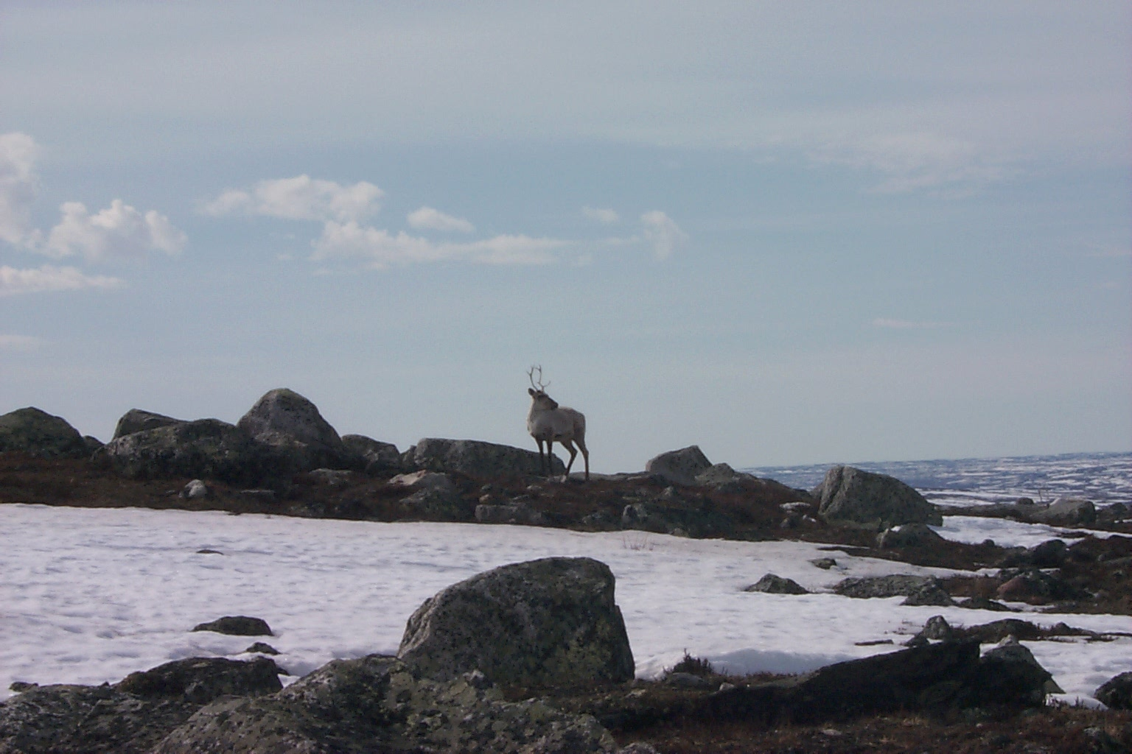
Qingaungmi 2015 Amigaitilaanginnik Nalautinniarhimaniit
Bathurst 2015 Population Estimate
2015-mi amigaitilaanginnik nalautinniarhimaniit una 19,700 tuktuit (ikikliyuummirhimayuq 35,000-nin tuktuinni 2012-mi).
Amigainiitigut qauyiharnikkut naunaitkutat tautuktittut aularaanginnaqtumik naunaitkutanik ikikliyuummiliqtunik tuktuinnik:
Taamna 2015 nalautinniarhimania 37%-mik ikitqiyauyuq talvannga 2012-mi amigaitilaanginni nalautinniarhimaniinni uvani 35,000-nguuyunahugiyauyuni tuktuinni
Piniqaqtuq atpahikhimaliqtumik itpangninganin arnarlungni annaumanirnirnik aktilaanginni talvannga 2007-min
Piniqaqtuq atpahikhimaliqtumik itpangninganin upinngaghani nurrani : kulavakni amigaitkutaqatigiinginni, ikittut nurriniit talvannga 2011-min
The 2015 population estimate was 19,700 caribou (down from 35,000 caribou in 2012).
Population demographic indicators show consistent indication of a declining herd:
The 2015 estimate is 37% lower than the 2012 population estimate of 35,000 caribou
There is a below normal adult female survival rate since 2007
There is a below normal calf : cow ratio, low productivity since 2011

Slide 10
GN DOE Recommendations
Piqarhuni nalautinniarhimayumik aularaanginnaqtaaqtumik anguniarnikkut aktilaanganik imaatut 1%-mik talvannga 2010-min (ihumagiyauyuq ikittuq ukiuqtaqtumi tuktuinni), anguniarniit 370 tuktunik/ukiumi taapkunannga tamarmik nunagiyauyunin aulapkaqtittingittuq tatja amigaitilaaghainnik.
Tuktuit ikikliyuummiqtiraanginnaqtut ikitqaluarhutik anguniaqtauyukhat Nunavunmi imaalu 2014-2015 nutqaqtitauhimatjutimi Nunatsiami piqarhuni 15-nik haviqutinik tuniyauhimayu aallangayunun hulitjutikhainnainnun.
Given an estimated sustainable harvest rate of 1% since 2010 (considered low for barren-ground caribou), a harvest of 370 caribou/year from both jurisdictions was not able to sustain current abundance.
The herd has continued to decline with minimal harvest in Nunavut and 2014-2015 moratorium in Northwest Territory with 15 tags allocated for ceremonial purposes only.

Slide 11
GN DOE Proposed Recommendations
Uumani ikikliyuummiqtirnikkut aktilaangani, tuktukhagliurnikkut, tuktuit hulaqutiqarniaqtut anguniaqtaukpata, taimaatut tuktuit qayangnarhingmata.
Kihimi, ataani Nunavut Nunatarnikkut Angirutimi (NLCA) ilitaritjutiqaqtuq piangaiyarnikkut anginiqarnirmik ukunani tuktuinni Qingaukmun Umingmaqtuumunlu inunginnun.
19,700 tuktuit x 0.15% anguniarnikkut aktilaanga = 30
NUNAVUNMI TAMATQIQHIMAYUT PITQUYAUHIMAYUT ANGUNIAQTAUYUKHAT
(NU TAH) = 30 anguhalluit
At this declining rate, biologically, the herd cannot sustain any harvest, as the herd is at very high vulnerability.
However, under the NLCA there is recognition of key economic importance of this herd to Bathurst and Bay Chimo outpost camps.
19,700 caribou x 0.15% harvest rate= 30
NU TAH = 30 males

