Slide 1
Pitquyautjutit Nunavut Uumayulirinikkut Munarinikkut Katimayiit (NWBM)
Tahiqpaup Kivataani
Recommendations to the NWBM
Bluenose-East Caribou
Nunavut Kavamat/Government of Nunavut
Avatiliqiyikkut Havakvia/Department of Environment
June, 2016

Slide 2
Nunavut Kavamatkunni Avatiliqiyikkut Havakviat havagutaa
Government of Nunavut, DOE mandate
Avatiliqiyikkut Havakviani Uumayulirinikkut havakviat maligakkut havagutiqaqtut munarinikkut nunani uumayunik Nunavunmi, ilauyullu aularaanginnaqtunik munarinirnik atauttikkut-aulapkaitjutainni Nunavumi uumayuni pitquyauhimayumi ataani Nunavunmi Nunatarnikkut Angirutimi (NLCA).
Atauhiuyuqlu pilluarumayainni turaanganirniani Havakviup pinikkut ihuaqtumik pitjutikhanik uumayuni munaritjutainni atuqpaktut tamarnik qauyiharutinik–naunaqtunik uumingalu Inuit Qaujimajatuqanginnik (IQ).
Havakniarhimayait
Havakniarhimayait Uumayulirinikkut Munarinikkut havakviat hapkuat:
Tuniluni uplumiutanik ilitturipkaitjutinik taapkunannga naliinni pivigiyauyunin;
Piliurluni uumayulirinikkut munarinikkut hivunikhanik munariniqatigiiqaqtuni paannariyainni hapummiyaami uumayunik amigainniinnik;
Tuniluni ikayurutinik aturutikhaniklu munariniqatigiiqaqtuni paannanun anguniaqtununlu; imaalu,
Pipkailuni maligakkut maligaghakkullu maliktauyut taapkunuuna iliharnikkut maliktipkainikkullu.
The DOE Wildlife Management division has a legislated mandate for the management of terrestrial wildlife species in Nunavut, including on-going responsibility for the co-management of Nunavut wildlife as obligated under the NLCA.
One of the primary goals of the Division is to achieve a balanced approach to wildlife management that uses both science and Inuit Qaujimajatuqangit (IQ).
Objectives
The objectives of the Wildlife Management division are to:
Provide up-to-date information from various sources;
Develop wildlife management plans with co-management partners in order to protect wildlife populations;
Provide support and resources to co-management partners and harvesters;
and,
Ensure legislative and regulatory compliance through education and enforcement.
Notes:
Bullet point:
1) including in-house scientific research and Inuit Qaujimajatuqangit, to co-management partners in order to make responsible wildlife management and land use recommendations;

Slide 3
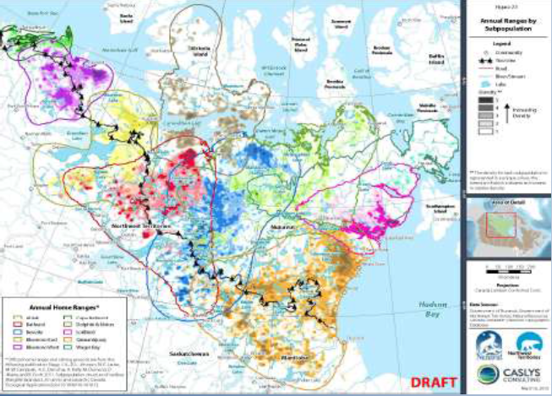
Munarinikkut Tuktunik – Humiinniit
Monitoring Caribou –Distribution
Nunami humiinniit nunami ukiiviit tuktuit. Ilangit nayugait tikitpaktut Yukon-mun, Alberta-mun, Saskatchewan-mun Manitoba-munlu .
Geographical distribution of barren-ground and tundra wintering caribou herd. Portions of ranges extend into Yukon Territory, Alberta, Saskatchewan and Manitoba .

Slide 4
Munarinikkut – Tahiqpaup Kivataani
Monitoring –Bluenose- East
Ilitturiyugut qilamik ikikliyuummirnirnik talvannga 2000-min 2005-minlu ilitturittiarhugulu 2006-mi. Talvannga amigaitqiyaungninganin imaatut 123,000 2010-mi, taapkuat Tahiqpaup-Kivataani tuktuit ikikliyut imaakiaq 68,000-nun 2013-mi.
We measure a rapid decline from 2000 and 2005 and confirm in 2006 . Then after a high of 123,000 in 2010, the Bluenose-East herd declined to an estimated 68,000 in 2013.

Slide 5
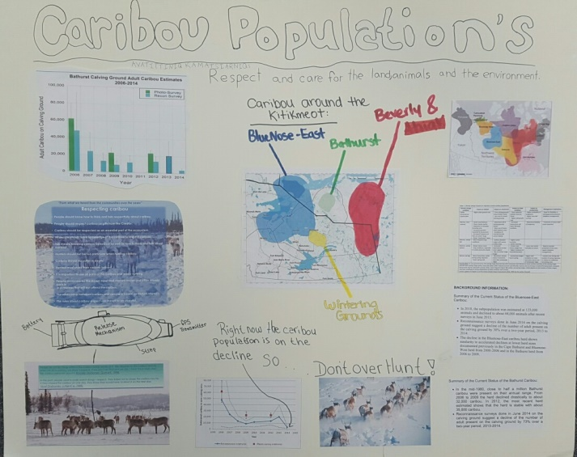
Miitiqtipkaitjutit
Consultations
Tatqiqhiutikkut/Ukiuq tamaat Tunnganiqarnikkut:
Unniutitjut qauyiharnirmi Anguhiqiyitkunnun (HTOs) ukunungalu Kitikmeot Avikturhimaningani Uumayulirinikkut Katimayiinnun (KRWB)
Unniutitjut inungnun
Monthly/Annual Basis:
Report on the survey results to the HTOs and KRWB
Report to the public

Slide 6
Miitiqtipkaitjutit
Consultations
Miitirniit:
Aularaanginnaqtut Munarinikkut hivunikhanik miitirniit
Aularaanginnaqtut Inungnun miitiqaqtiigiikniit
Aallangayuq huliniq “Tuktutigut havainiq”
Katimaniit uvani Ualliani Kitikmeot tuktuit qanurinningani, imaa 2007-mi katimanirmi Kugluktukmi
Meetings:
Ongoing Management plan meetings
Ongoing Public consultations
Special event “Caribou week”
Workshops on West Kitikmeot caribou status, such as the 2007 workshop in Kugluktuk

Slide 7
Nunallaani-tunnganiqaqtuq Munarinikkut Qanuriliurniit
Community-based Management Actions
Ilihimanikkut qauyihainikkut pinahuarutit.
Aallanik anguniarnikkut aallanik huratjanik, imaakiaq umingmangnik.
Pingilluni ahinin nunanin anguniarnirnik maniliurniarhimanikkulluunniit anguniarnirnik ukunani Tahiqpaup Kivataani tuktunik Nunavunmi (Kugluktuk HTO).
Akhuurlunik ilaulutik miitiqatigiiknirni/miitirnirni/katimanirni.
Education awareness programs.
Shift in harvest to alternative species, such as muskox.
No sport or commercial harvest of Bluenose East caribou in Nunavut (Kugluktuk HTO).
Strong participation at consultations/meetings/workshops.

Slide 8
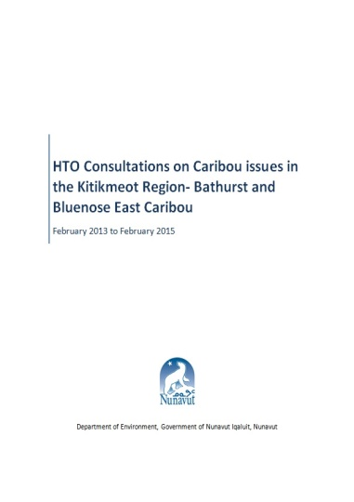
2014-2015 Consultations
  September 9, 2014 - Kugluktuk HTO katimayiit miitirniq
  September 22, 2014 - Kugluktuk ilitturipkainiq miitiqatigiiknirlu
  October 9-10, 2014 - Naunavyaktuni Miitirniq 1, GN-kut NTI-kullu ilauyut
  October 15-18, 2014 - KRWB Ukiungani Miitirniq
  October 22-23, 2014 - Naunavyaktuni Miitirniq 2, GN-kut ilauyut
  October 31, 2014 - Kugluktuk HTO katimayiit miitiqtut.
  February 11, 2015 – Kugluktuk HTO (TAH)
  September 9, 2014 - Kugluktuk HTO board meeting
  September 22, 2014 - Kugluktuk community information and consultations
  October 9-10, 2014 - Technical Meeting 1, GN and NTI participation
  October 15-18, 2014 - KRWB AGM meeting
  October 22-23, 2014 - Technical Meeting 2, GN participation
  October 31, 2014 - Kugluktuk HTO board meeting.
  February 11, 2015 – Kugluktuk HTO (TAH)

Slide 9
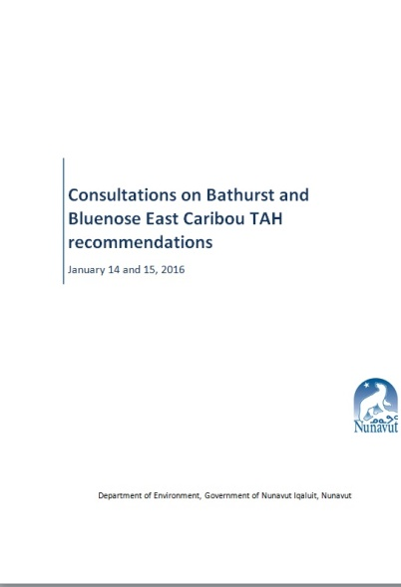
Tuktuni Anguniaqtauyukhani Miitiqtipkaitjutit 2016
Caribou Harvest Consultation 2016
January 2016-mi
Miitiqaqtigivaktait hulaqutihimayut Anguhiqiyitkut (HTOs) Kitikmeot Avikturhimaningani Uumayulirinikkut Katimayiinnunlu (KRWB), ukunani aallanguqtirhimayuni nutaani Tamatqiqhimayut Pitquyauhimayut Anguniaqtauyukhat (TAH) pitquyauhimayuni (Ikaluktuuttiaq).
March 2016-mi, GN D0E tuniyuq tukhiqtauhimayunik pitquitjutimik Tamatqiqhimayut Pitquyauhimayut Anguniaqtauyukhat (TAH) imaatut 340 anguhallunik tuktunik uvani Tahiqpaup Kivataani tuktuinni ukununga Nunavut Uumayulirinikkut Munarinikkut Katimayiinnun (NWMB)
In January 2016
Consulted with the affected HTOs and KRWB, on the adjusted new TAH recommendations (Cambridge Bay).
In March 2016, GN D0E submitted proposed recommended TAH of 340 male caribou for the Bluenose East herd to NWMB

Slide 10
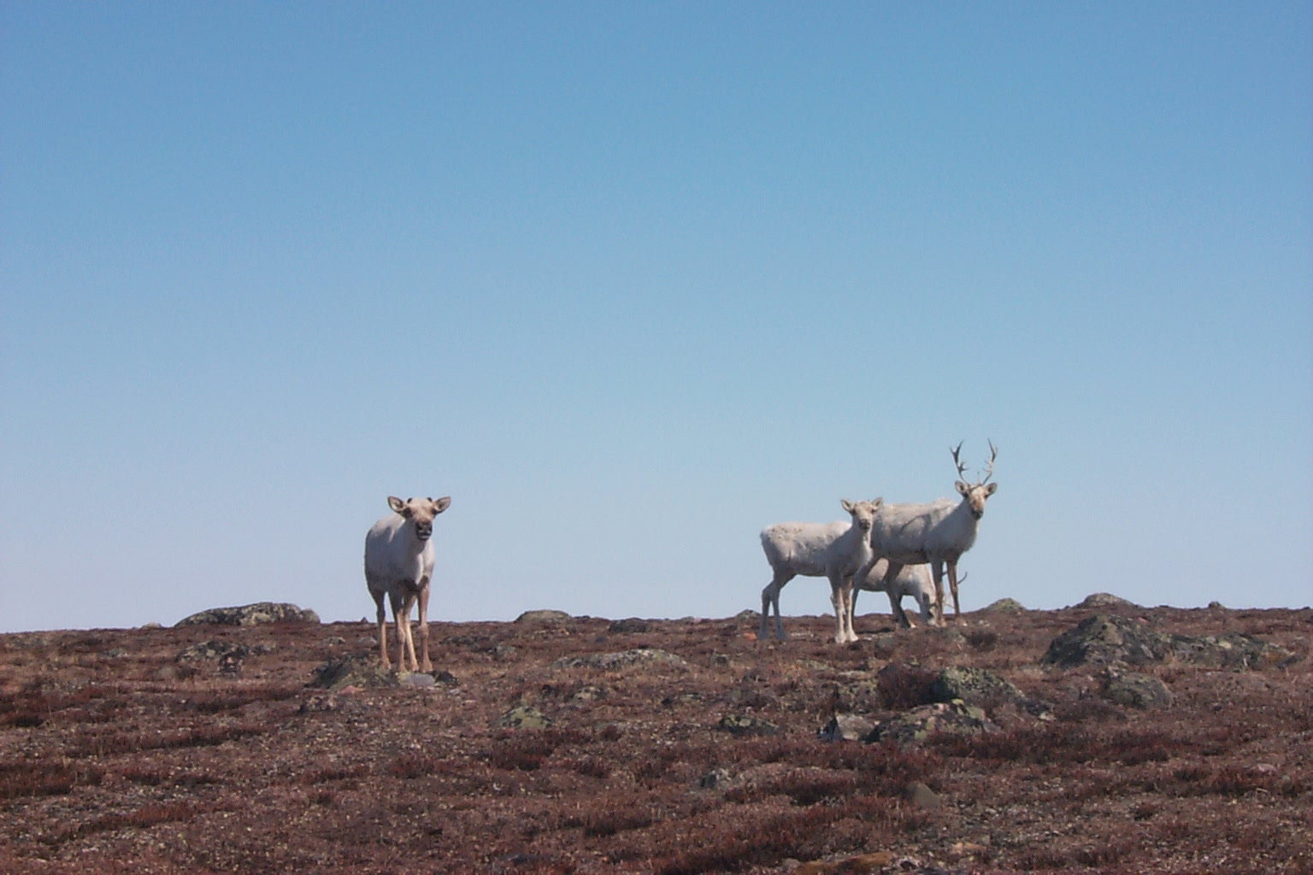
Tahiqpaup-Kivataani 2015 Amigaitilaanginnik Nalautinniarhimaniit
Bluenose-East 2015 Population Estimate
2015-mi amigaitilaanginnik nalautinniarhimaniit una 38,592 tuktuit (ikikliyuummirhimayuq 68,000-nin tuktuinni 2013-mi).
Amigainiitigut qauyiharnikkut naunaitkutat:
Angiyumik ikikliyuummirniqaqtuq 2013-min amigaitilaanginni nalautinniarhimanirnin imaa 68,000 tuktuinni, 21% ukiuq tamaat ikikliyuummirnikkut aktilaanga
Piniqaqtuq atpahikhimaliqtumik itpangninganin arnarlungni annaumanirnirnik aktilaanginni talvannga 2012-min
Piniqaqtuq atpahikhimaliqtumik itpangninganin upinngaghani nurrani : kulavakni amigaitkutaqatigiinginni, ikittut nurriniit talvannga 2012-min
The 2015 population estimate was 38,592 caribou (down from 68,000 caribou in 2013).
Population demographic indicators:
There is a significant decline from 2013 population estimate of 68,000 caribou, 21% annual decline rate
There is a below normal adult female survival rate since 2012
There is a below normal spring calf : cow ratio, low productivity since 2012

Slide 11
GN DOE Recommendations
Anguniarnikkut munarinikkut pinahuaruti nalautinniarhimayait tamainni anguniarnirni (tamainni pivikni) imaatut 3,500 tuktuit. Uvani, niqirhakkut anguniarniit Nunavunmi nalautinniarhimayut imaa 1000 – 1500 (1250) tuktuit ukiuq tamaat, pitjutipluni 36%-mik tamainni anguniarnirni.
Harvest monitoring program estimates overall harvest (all sources) in the order of 3,500 caribou. Of this, subsistence harvest in Nunavut is estimated between 1000 – 1500 (1250) caribou annually, representing 36% of overall harvest .

Slide 12
GN DOE Proposed Recommendations
38,000 tuktuit x 2.5% anguniarnikkut aktilaanga = 950 tuktuit talvani tamatqiutihimayunik anguniaqtauyukhani (tamainnin piviknin)
Taimaatut 1250/3500 = 36%
950 tuktuit x 36%= 340 tuktuit Nunavunmun
NUNAVUNMI TAMATQIQHIMAYUT PITQUYAUHIMAYUT ANGUNIAQTAUYUKHAT
(NU TAH) = 340 anguhalluit
38,000 caribou x 2.5% harvest rate = 950 caribou in total harvest (all sources)
Where 1250/3500 = 36%
950 caribou x 36%= 340 caribou for Nunavut
NU TAH = 340 males

