Slide 1
Kitikmeot Inuit Association
Submission to the NWMB for the GN Bathurst Caribou TAH Proposal
March 5-7, 2020

Slide 2
Purpose of Presentation
Present a summary of KIA’s views of the Proposal for a Total Allowable Harvest (TAH) of 0 for Bathurst Caribou requested by the Government of Nunavut (GN) to the Nunavut Wildlife Management Board (NWMB).

Slide 3
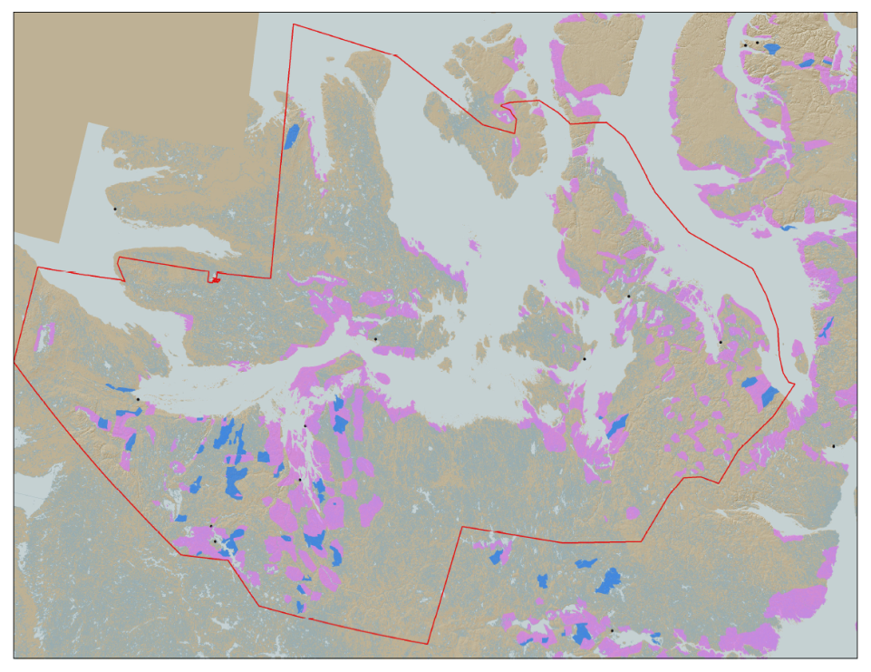
KIA’s Mandate
KIA’s Mandate is to manage Kitikmeot Inuit lands and resources, and to protect and promote the social, cultural, political, environmental, and economic well-being of Kitikmeot Inuit.

Slide 4
Background to KIAs Submission
KIA is working with the Kugluktuk and Ekaluktutiak Hunters and Trappers Organizations (HTOs), the Kitikmeot Regional Wildlife Board and Nunavut Tunngavik Inc. (NTI).
Caribou are of central important to Inuit culture

Slide 5
KIAs Position on the TAH
KIA opposes the GN TAH proposal.
Reasons:
  The Inuit family at Contwoyto Lake should be permitted to maintain a subsistence lifestyle and contribute to caribou management
  GN needs a balanced approach that minimally infringes on Inuit rights
  GN proposal does not include TK or IQ

Slide 6
Analysis and Argument: Continuity of Inuit Culture and Subsistence
TAH of 0 will
  impact continuity of Inuit culture
  impose undue hardship on Inuit family living at Contwoyto Lake
  eliminate the caribou monitoring and conservation role currently performed by this family
  not accelerate or measurable change the decline of the Bathurst herd

Slide 7
Analysis and Argument:
Minimal Infringement and Inuit Management
The Nunavut Agreement and the Constitution require that conservation action minimally infringe on Inuit rights
October 7, 2019 meeting with HTOs, HTOs requested predator management for wolves and grizzly bears
GN proposing to eliminate harvesting without managing other threats (i.e. predators)
GN should support creation and implementation of Inuit led conservation management plan

Slide 8
Analysis and Argument: Need to Include TK and IQ
GN conducted limited community meetings
Comments from the community are not reflected in the proposal
Proposal does not appear to include any TK or IQ

Slide 9
Summary
Conservation of Bathurst caribou requires a balanced approach, including predator management
Conservation management should be Inuit led and utilize TK and IQ, with support from GN for developing and implementing the approach
Conservation must be consistent with Inuit rights, including minimal infringement on Inuit harvesting rights
The TAH should be set at 10, allocated to the family at Contwoyto Lake for subsistence harvesting

Slide 10
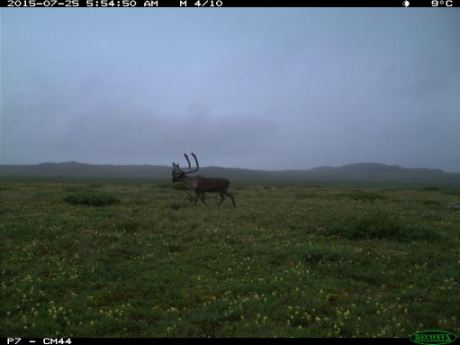
Thank You

